Slide 1
EVOLUTION TEST REVIEW SLIDES
Test on Friday 4/07

Slide 2
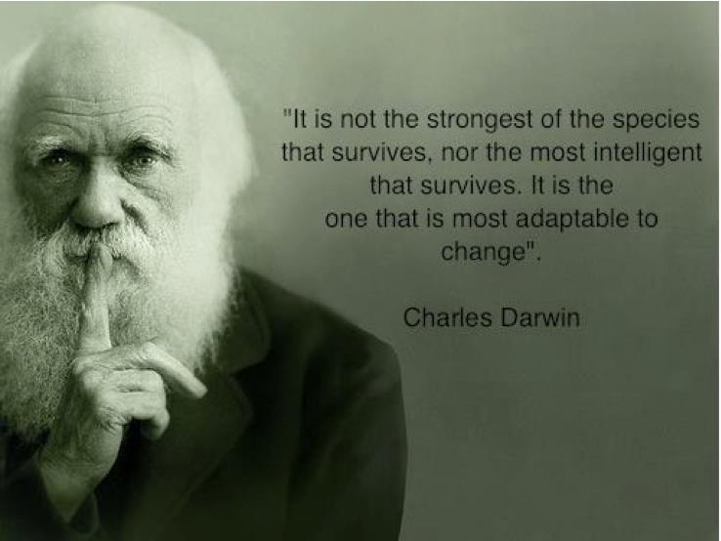

Slide 3
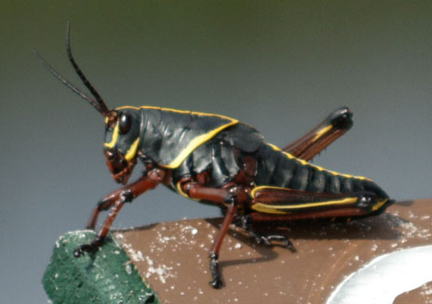
Variation in Species Lab
All species have variation. What are some variations you noticed in the size of:
  Peas
  Grasshopper femurs
  Eye width
What are some advantages and disadvantages to these variations?
How do these variations impact evolution?
How did you plot these on a graph and what was the general shape?

Slide 4
GRASSHOPPER FEMUR LENGTH TOTAL DATA
100
#
OF
H
O
P
P
E
R
S
0
10
20
25
30
35
40
45
50
FEMUR LENGTH (mm)

Slide 5
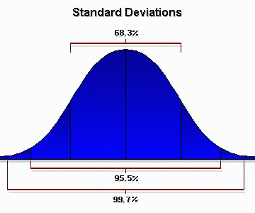
Bell Curve

Slide 6
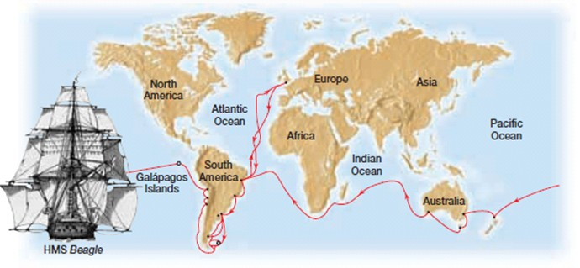

Slide 7
EVOLUTION BY MEANS OF NATURAL SELECTION

Slide 8
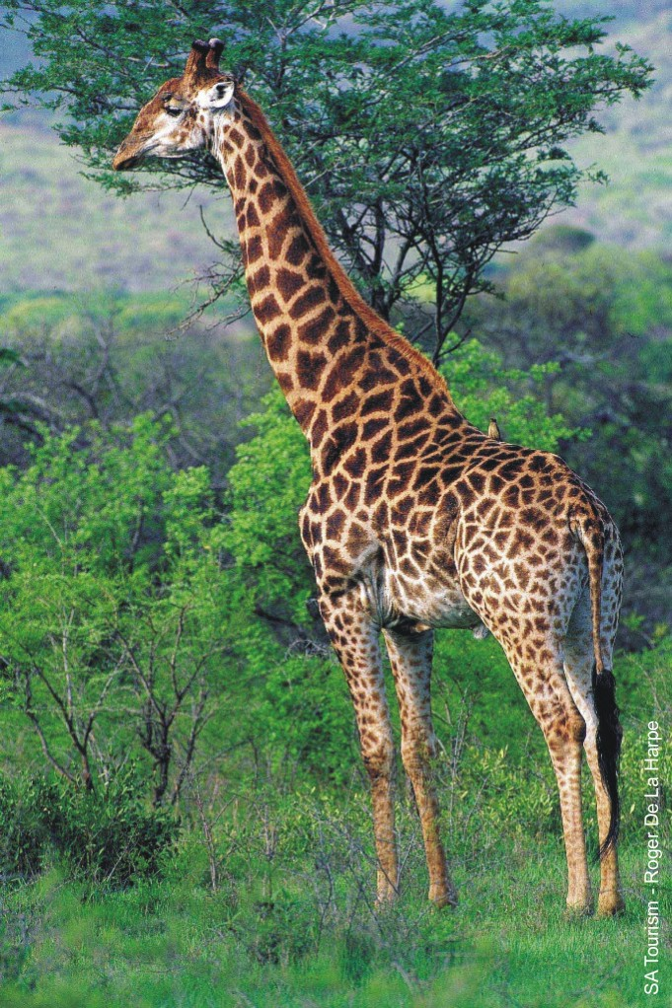
1. What adaptations does this organism have?
2. How did these adaptations evolve?
3. How do they enable the organism to survive in its environment?
They have long legs and neck, long, tough, prehensile tongue, and leathery mouth for food gathering. Their coloration is protective. They are tall with good eyesight for watchfulness. Giraffes have high blood pressure (240/160) for pumping blood to the brain. Long neck for reaching its food source (leaves)

Slide 9
EVOLUTION BY MEANS OF NATURAL SELECTION
5 Principles

Slide 10
1. Variation
All species have variations
Variation is the raw material for natural selection
Ex: Variations in giraffes

Slide 11
2. Struggle for Existence
Organisms produce more offspring than can survive.
The environment produces struggles organisms must surpass to
survive

Slide 12
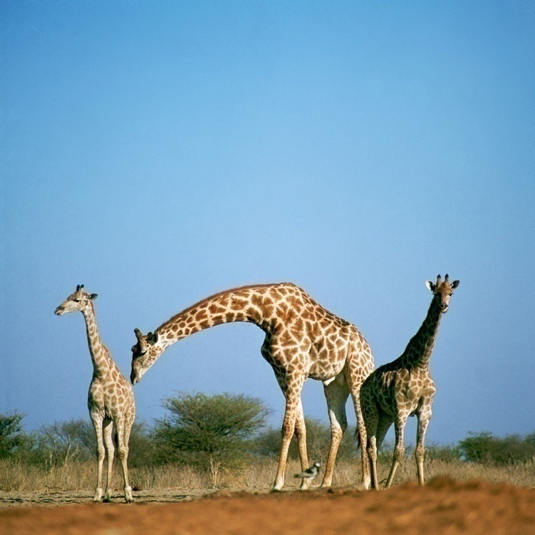
3. Only some survive to reproduce
Some are better able to survive and reproduce (pass on their genes)

Slide 13
4. Natural selection results in genetic change
Each generation contains an increased proportion of individuals with traits that promote survival and reproduction.
What are some alleles that a successful giraffe might have?
    Neck length
    Leg length

Slide 14
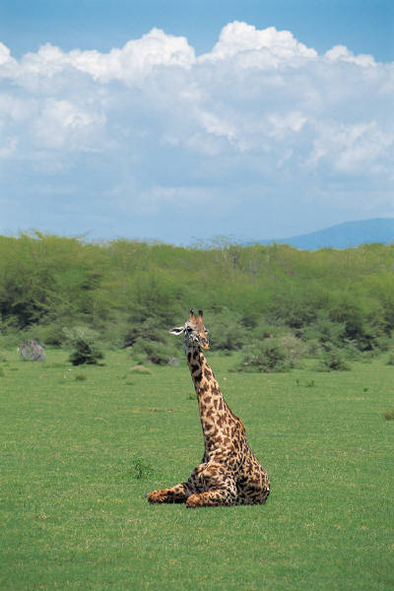
5. Species adapt to their environment
Selection makes a population better suited to it’s environment.
The environment determines
the direction of genetic change.

Slide 15
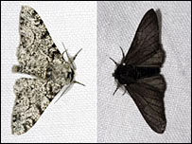
The Peppered Moth

Slide 16
http://peppermoths.weebly.com/

Slide 17
Evolution: Another Example!
Peppered Moth
There are 2 variations of peppered moth: light and dark
Prior to the industrial revolution – white was favored because the tree trunks were white. Why?
Post-industrial revolution – black became more common. Why?
Why? How do predators and environments drive evolution?

Slide 18
Driving Force of Evolution: Environment/Niche
How can an organisms niche be a selective force?

Slide 19
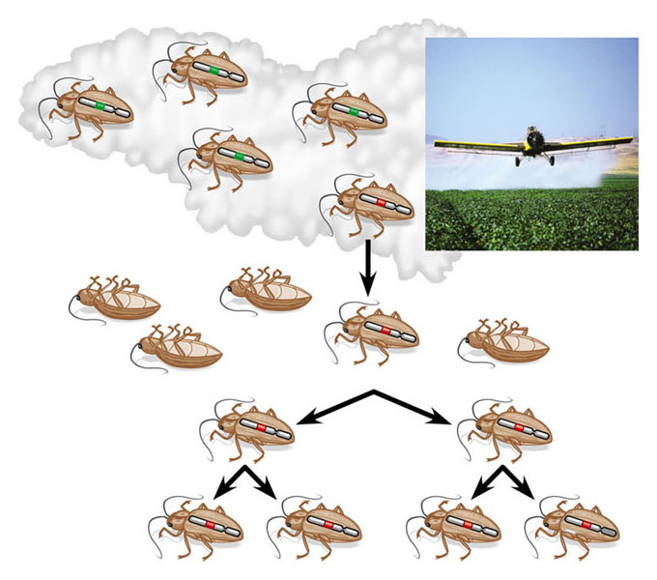
Another Natural Selection Example
Chromosome with gene
conferring resistance
to pesticide
Pesticide application
Additional
applications of the
same pesticide will
be less effective, and
the frequency of
resistant insects in
the population
will grow
Survivor

Slide 20
Driving Force of Evolution:
Competition
Limiting factors – any condition of the environment that limits the size of a population
Carrying capacity – The number of organisms that can be supported by a particular ecosystem
Overpopulation - the condition of having a population so dense as to cause environmental deterioration, an impaired quality of life, or a population crash

Slide 21
Bell Curve

Slide 22
Types of Selection
The types of selection relate to the bell curve. The bell curve is altered due to forces of nature favoring certain traits over other.
Stabilizing
Disruptive
Directional
  Note about sexual selection:
    https://www.youtube.com/watch?v=4j7GSu99LmY
    https://www.youtube.com/watch?v=VjE0Kdfos4Y
    https://www.youtube.com/watch?v=Fjk40qfcfj4
    https://www.youtube.com/watch?v=1XkPeN3AWIE
    https://www.youtube.com/watch?v=W7QZnwKqopo

Slide 23
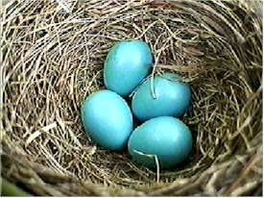
Stabilizing – the average is favored, the extremes are eliminated
Clutch size (amount of eggs laid) in starlings is between 3 and 6.
Clutch size is a genetic trait
Why are birds who only lay 1-2 eggs eliminated from the population?
Why are birds who lay 7-9 eggs eliminated from the population?

Slide 24
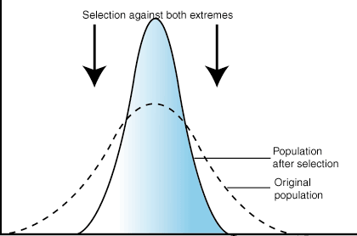
How would the bell curve change to reflect stabilizing selection?

Slide 25
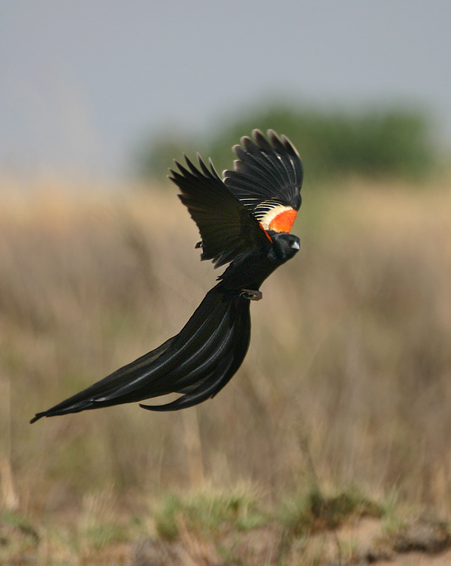
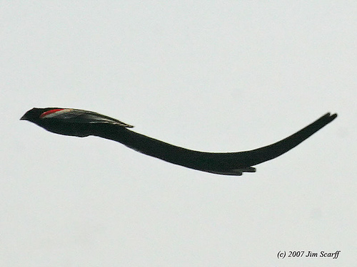
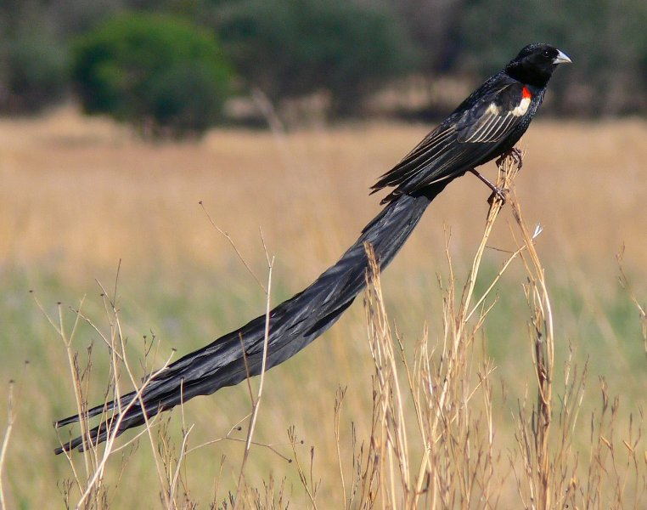
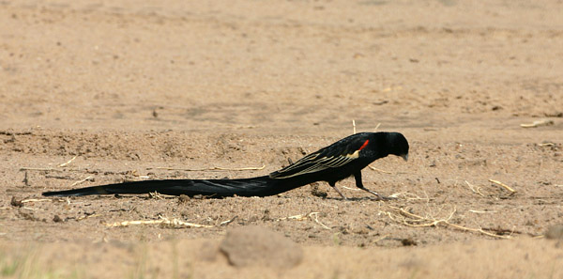
Directional Selection – Favors one extreme in a population, the other is eliminated
The male widowbird collects females for his “harem” by attracting them by the length of his tail. The longer the tail, the more females he attracts and mates with.
Why aren’t there male widowbirds with short tails?
Why don’t the males tails continue getting longer?

Slide 26
Selective pressures are environmental
factors which may reduce reproductive success
in a population and thus contribute to
evolutionary change or extinction through the
process of natural selection.
Examples:
  competition
  predation
  disease
  parasitism
  land clearance
  climate change
  pollutants.

Slide 27
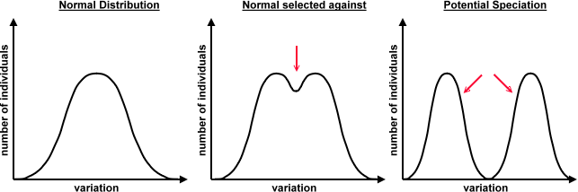

Slide 28
Evolution of Galapagos Finch
http://www.hhmi.org/biointeractive/origin-species-beak-finch
http://www.hhmi.org/biointeractive/making-fittest

Slide 29
Convergent Evolution
When organisms of different species are subjected to the same selective pressures, they evolve similar structures. These structures are not due to speciation and there is not a common ancestor.
Examples:

Slide 30
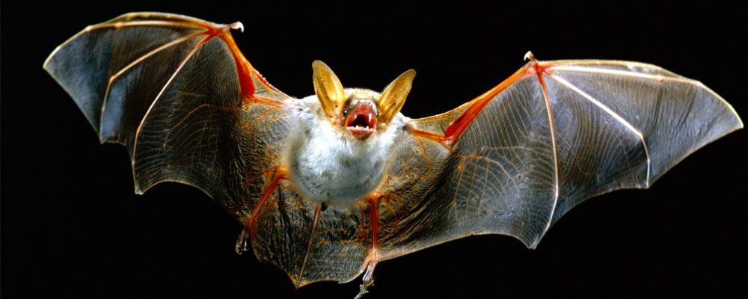
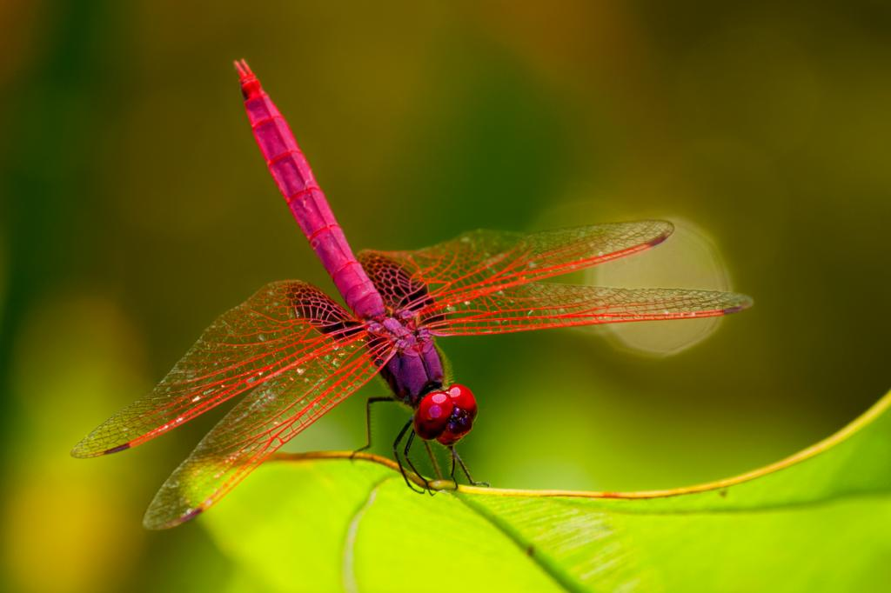
Analogous structures

Slide 31
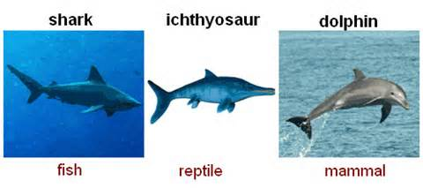

Slide 32
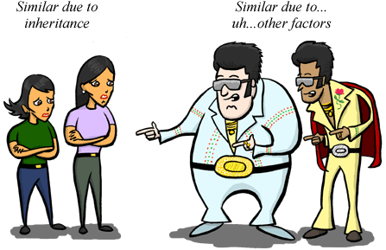
HOMOLOGY vs. ANALOGY

Slide 33
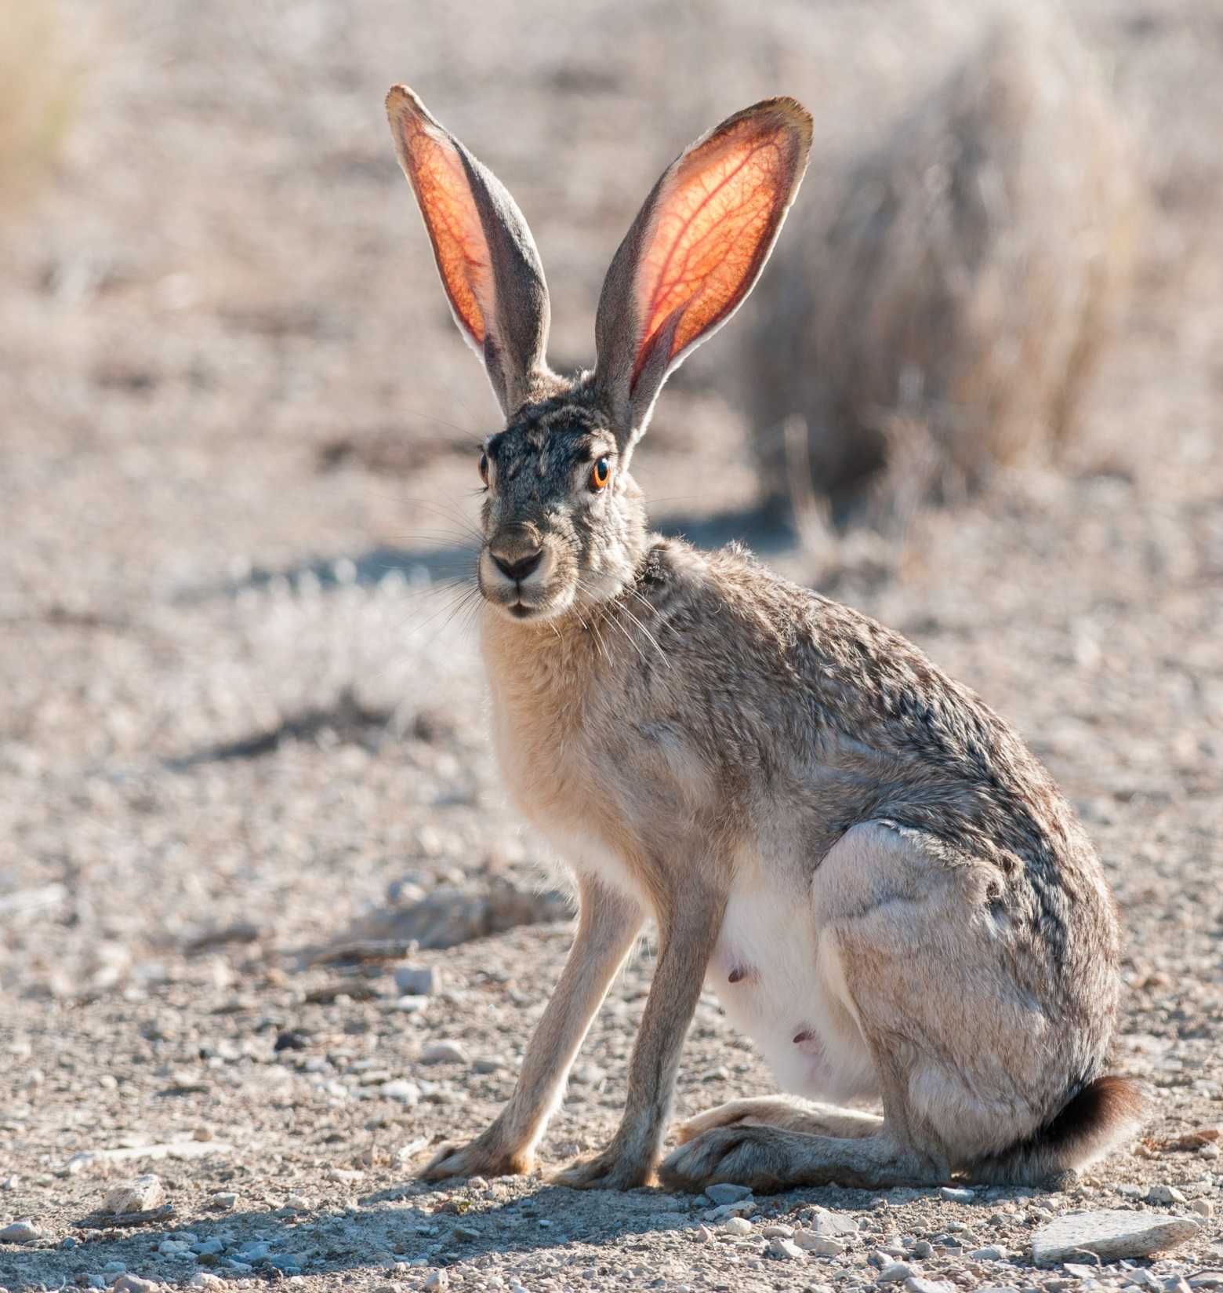
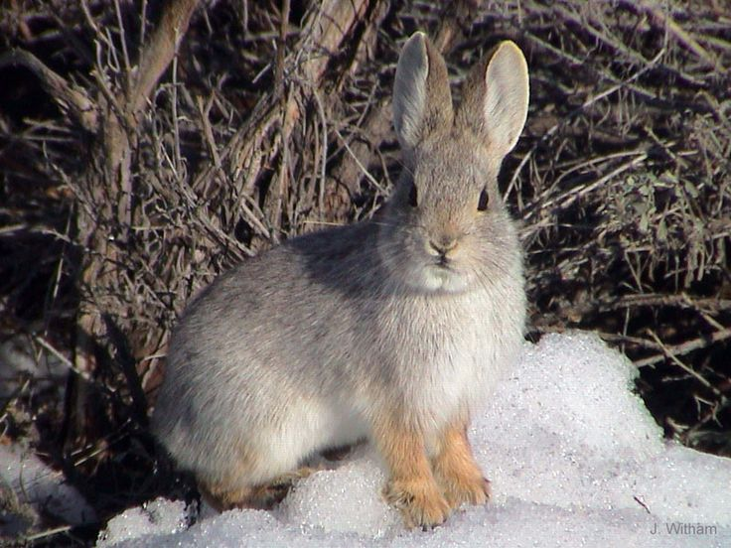

Slide 34
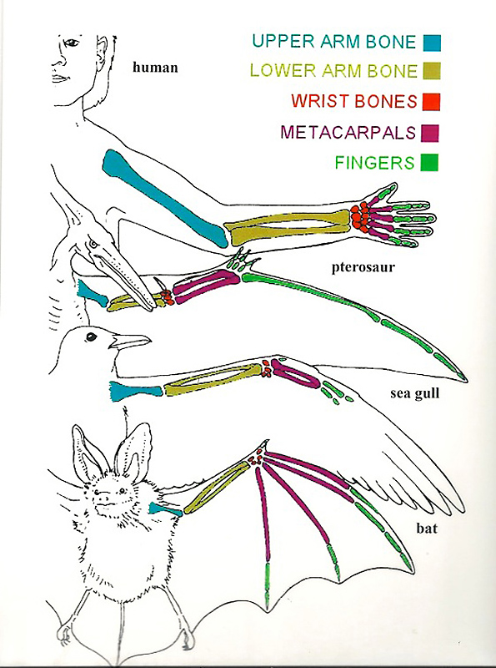
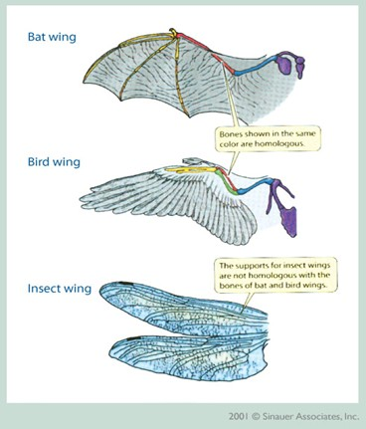

Slide 35
Analogous Structures
Superficially similar. They perform similar functions, but evolved independently of each other due to similar selective forces acting on a population.
Examples?

Slide 36
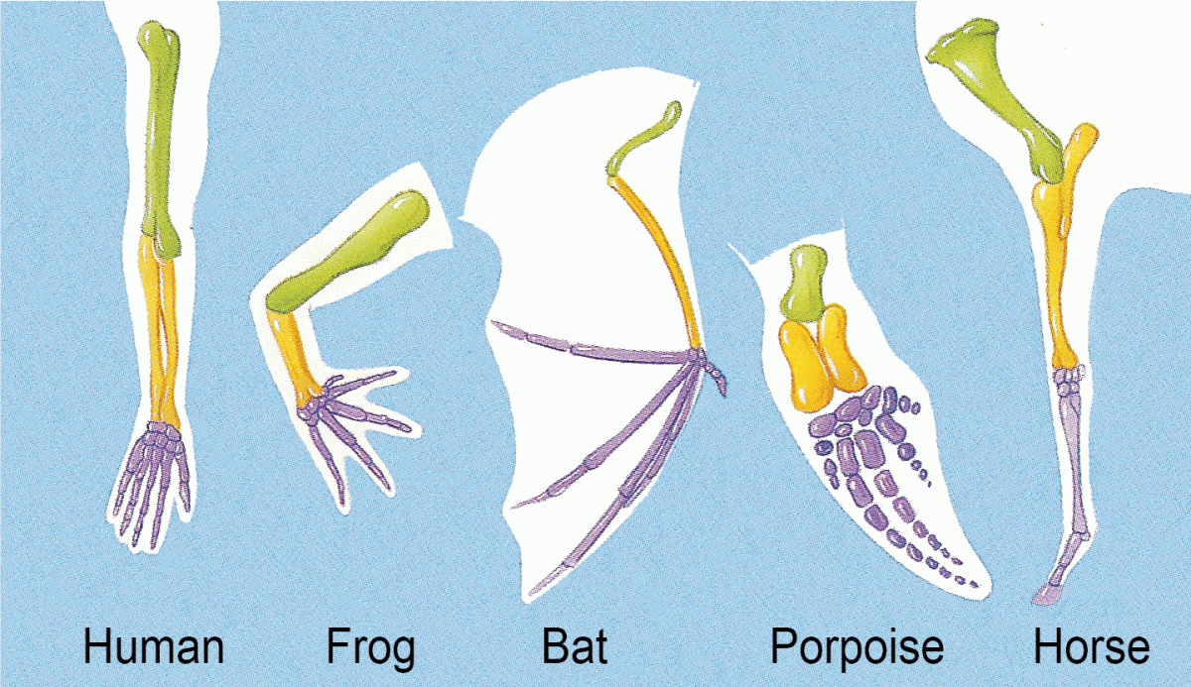
Homologous Structures
Evidence of Evolution
Anatomically similar structures inherited from a common ancestor. Because there was a common ancestor, the descendants of this animal demonstrate modified body parts that evolved through adaptation to various environments.
Some variations in the populations were more favorable and thus allowed the animal to be more successful and spread this modification throughout the population.
Descent with modification.

Slide 37
Convergent vs. Divergent Evolution
Original Population
Original Population
Original Population

Slide 38
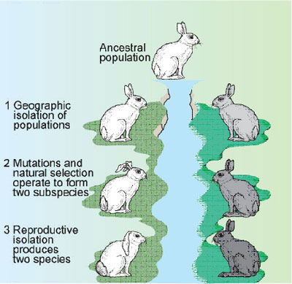

Slide 39
Mechanisms of Speciation and Evolution
The raw material for speciation is variation, which comes from sexual reproduction.
Occasionally, a mutation can spur evolution. A mutation can be:
  1. Helpful
  2. Harmful
  3. Neutral

Slide 40

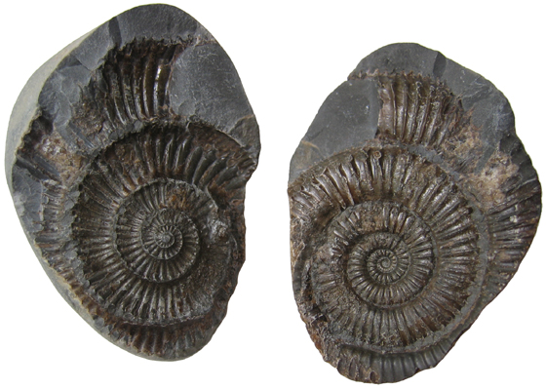
Evidence of
Evolution
Fossils
  Bones, casts, footprints, amber, ice
Homologous structures
Comparative embryology
Vestigial structures
Biochemical (DNA and amino acids)

Slide 41
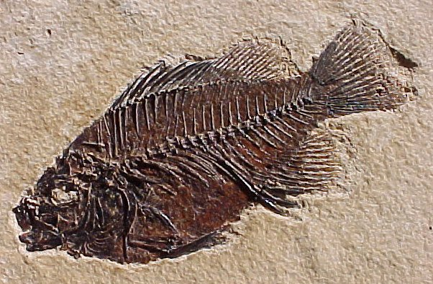
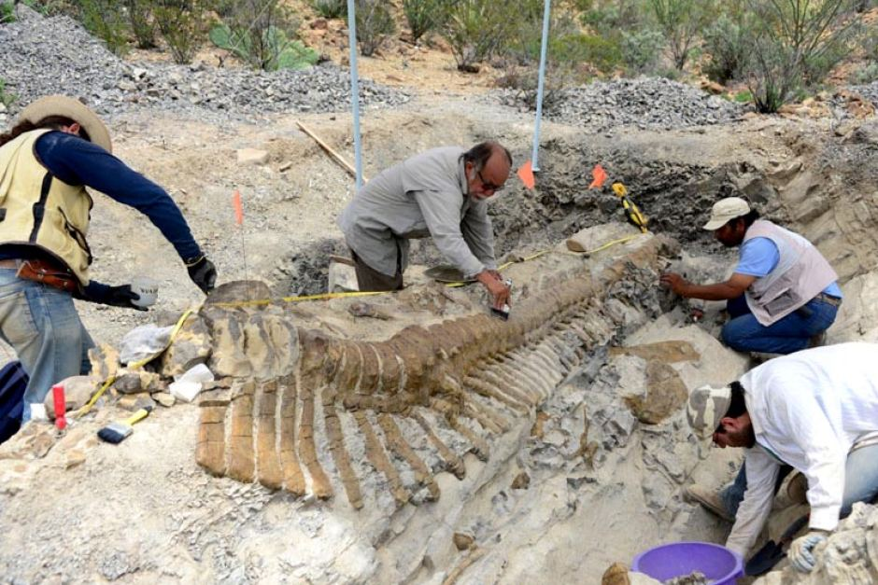
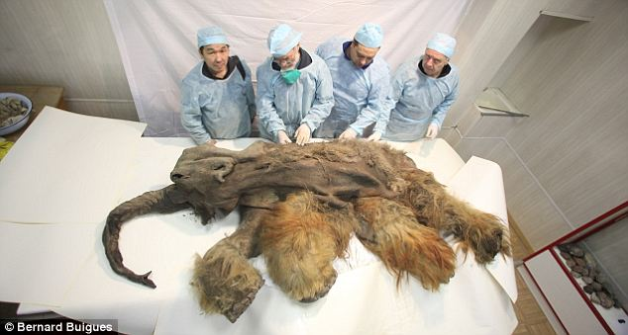
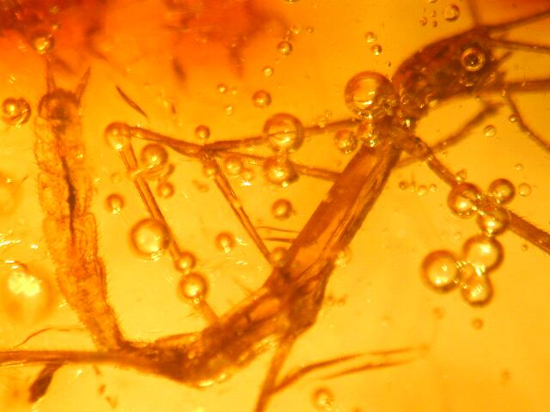

Slide 42
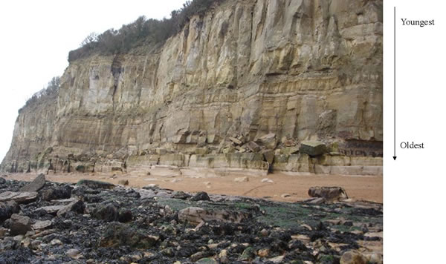
Fossils
Fossils are often found in sedimentary rock, which is formed from layers of silt and sand covering dead organisms.
The oldest are found on the lowest
layers, youngest in the upper layers

Slide 43
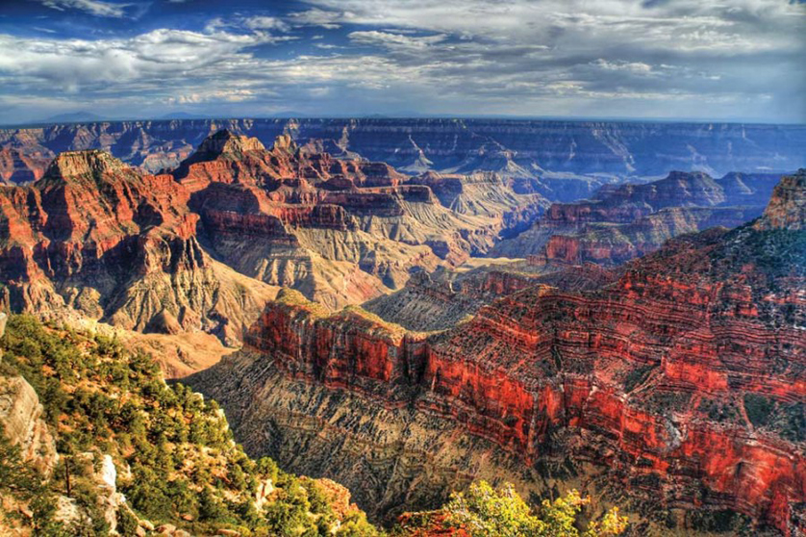

Slide 44
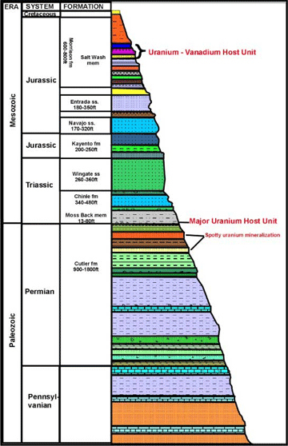

Slide 45
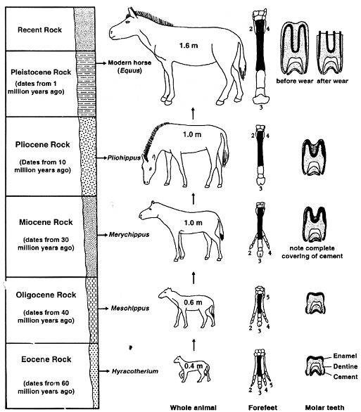

Slide 46
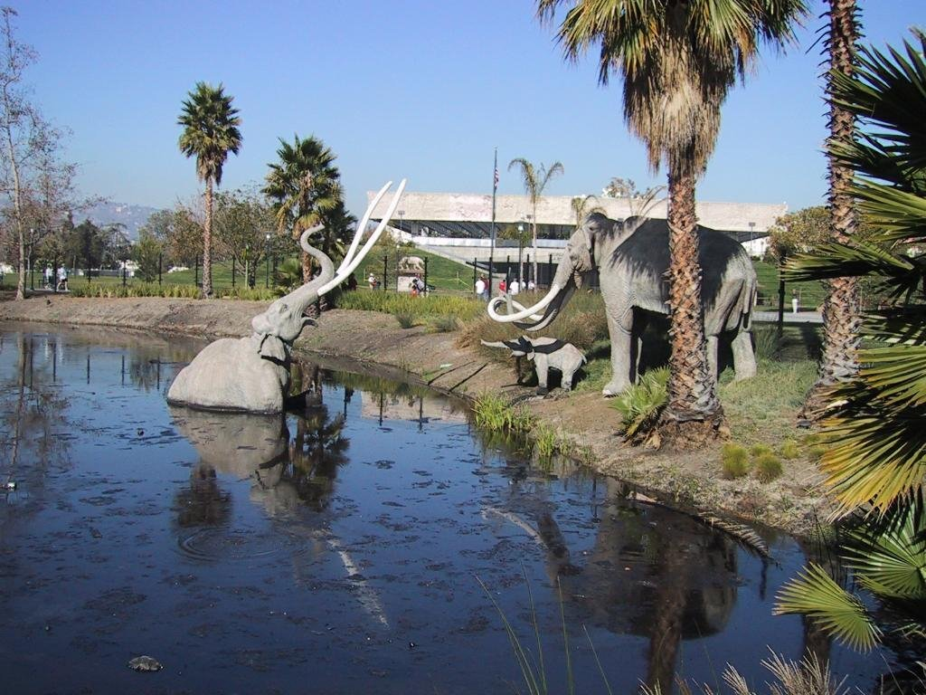
LA BREA TAR PITS - CALIFORNIA

Slide 47
Fossils, cont…

Slide 48
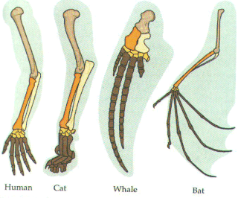
Homologous Structures

Slide 49
Calf
Human
Fish
Tortoise
Salamander
Chicken
Rabbit
hog

Slide 50
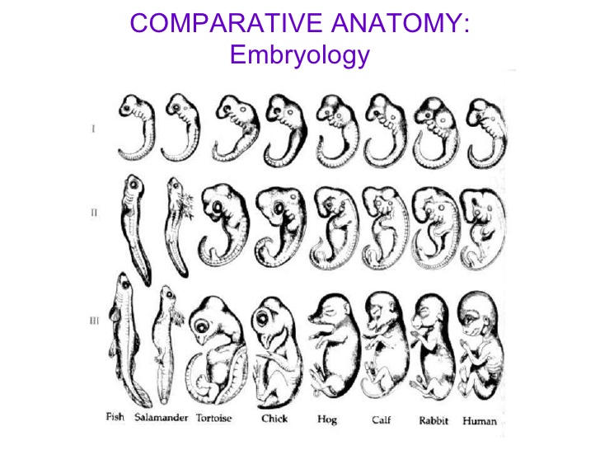

Slide 54
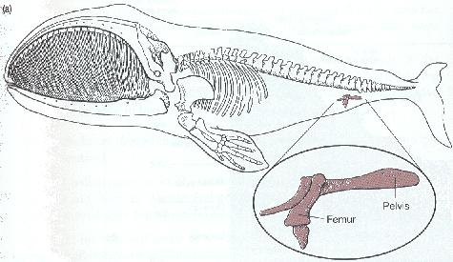
Vestigial Structures

Slide 55
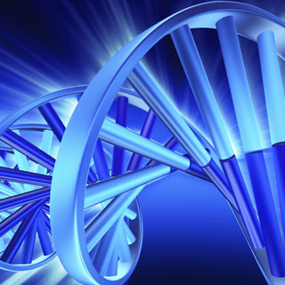
Biochemical/DNA Evidence
The closer the DNA sequences of 2 organisms are, the more closely related they are.
  Ex. Humans and chimps have DNA that is 99% identical

Slide 56
END OF TEST MATERIAL
TEST ON FRIDAY 4/7

